Slide 1
Ensemble Based Methods and Bagging

Slide 2
Learning Goals
In this section, we will cover:
- Combining models (ensemble-based methods)
- Bootstrap aggregation (Bagging)
- Bagging, Random Forest, and Extra Trees Classifiers

Slide 3
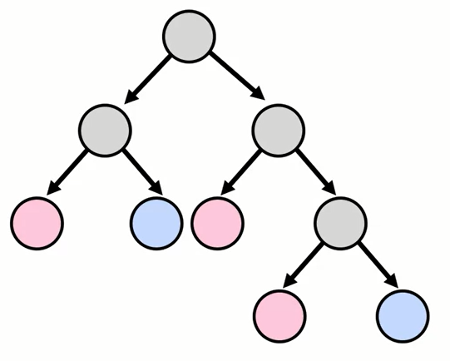
Decision Trees are High-Variance
- Problem: decision trees tend to overfit.
- Pruning helps reduce variance to a point.
- Often not significant for model to generalize well.

Slide 4
Ensemble Based Method
Ensemble means a group of elements viewed as a whole rather than individually. An Ensemble method creates multiple models (trees) and combines them to solve it. Ensemble methods help to improve the robustness/generalizability of the model.
Basic ensemble methods:
Averaging method: It is mainly used for regression problems. The method consists of building multiple models independently and returning the average of the prediction of all the models. In general, the combined output is better than an individual output because variance is reduced.
Max voting: It is mainly used for classification problems. The method consists of building multiple models independently and getting their individual output called ‘vote’. The class with maximum votes is returned as output.

Slide 5
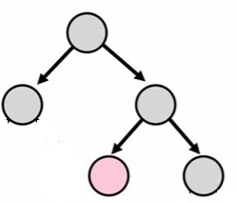
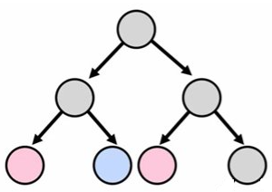
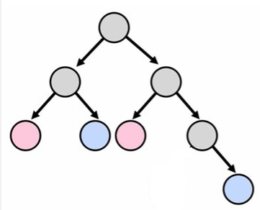
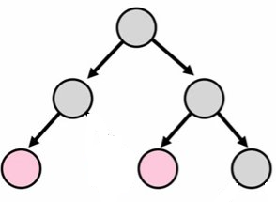
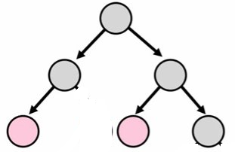
Ensemble Based Method

Slide 6
Ensemble Based Method
The variance is eliminated when multiple models are combined to form a single prediction that is chosen from all other possible predictions from the combined models. An ensemble of models combines various models to ensure that the resulting prediction is the best possible, based on the consideration of all predictions

Slide 7
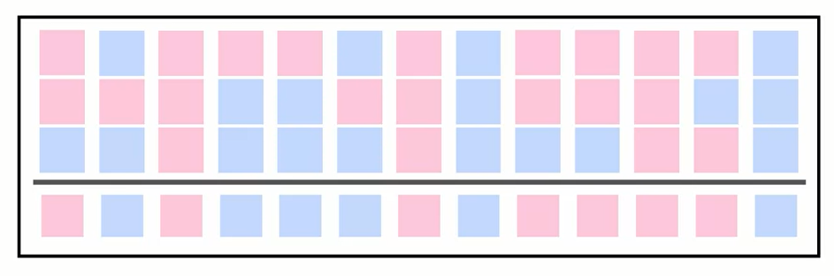
Aggregate Results
Trees vote on or average result for each data point

Slide 8
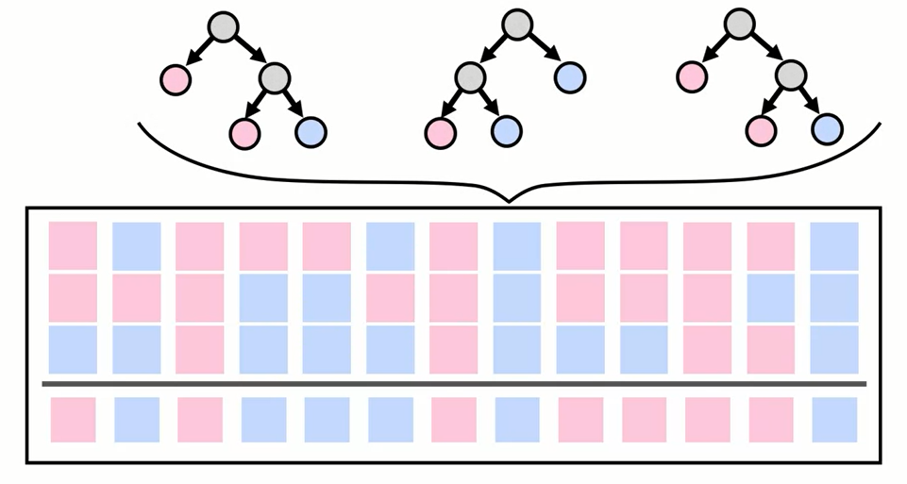
Aggregate Results
Trees vote on or average result for each data point

Slide 9
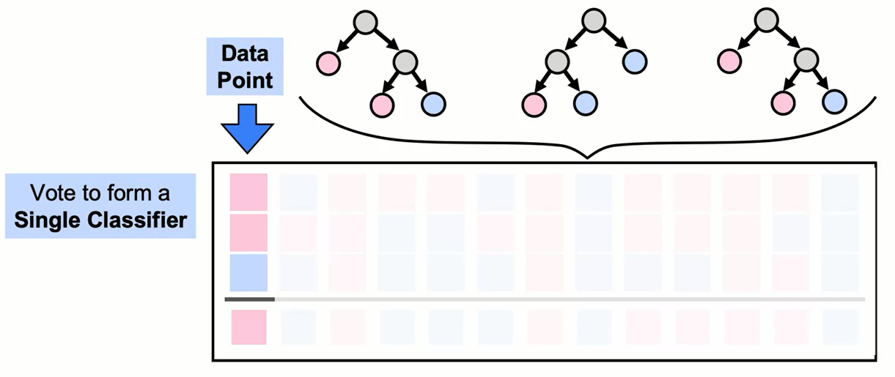
Aggregate Results
Trees vote on or average result for each data point

Slide 10
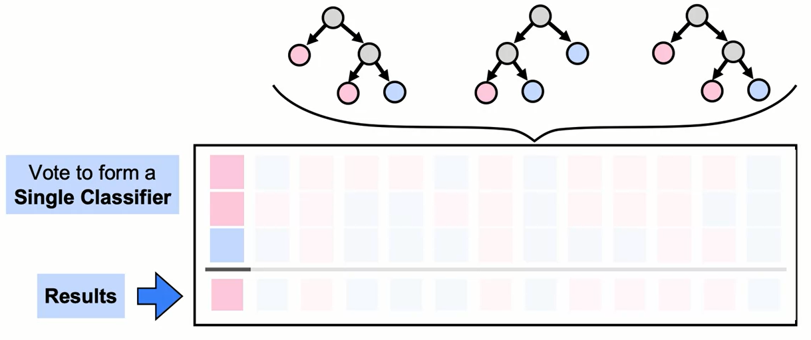
Aggregate Results
Trees vote on or average result for each data point

Slide 11
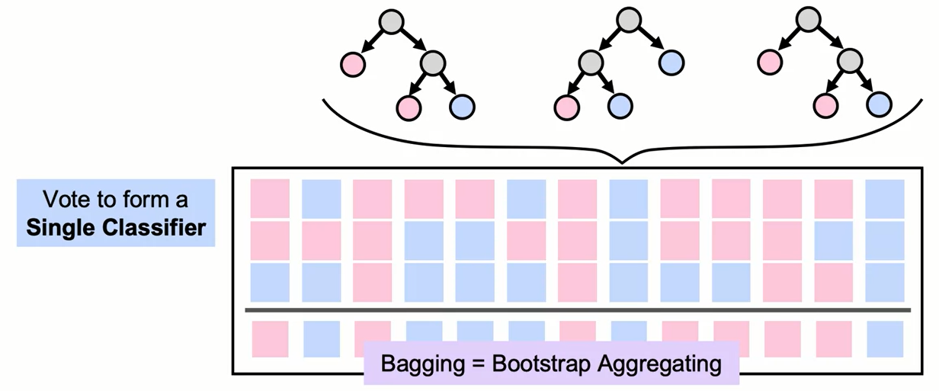
Aggregate Results
Trees vote on or average result for each data point

Slide 12
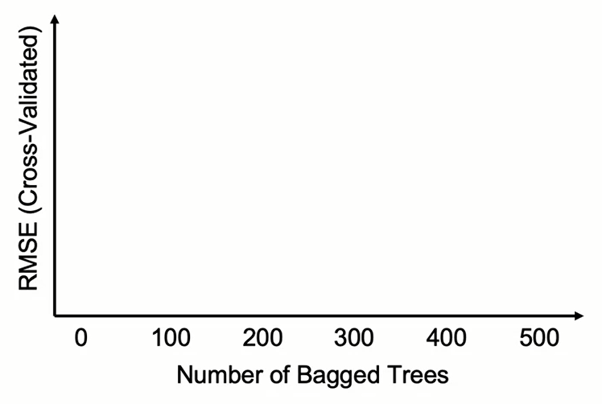
How Many Trees to Fit?
- Bagging performance improvements increase with more trees.

Slide 13
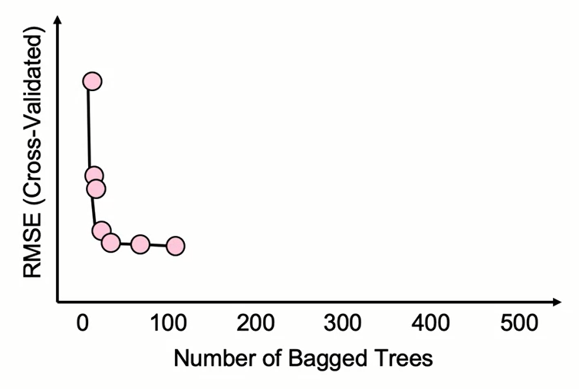
How Many Trees to Fit?
- Bagging performance improvements increase with more trees.

Slide 14
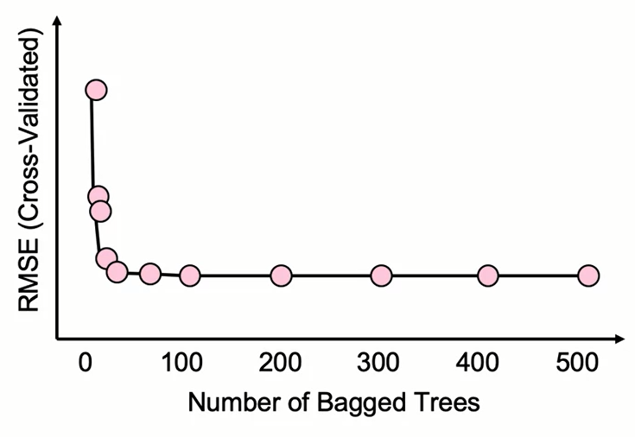
How Many Trees to Fit?
- Bagging performance improvements increase with more trees.
- Maximum improvement generally reached ~50 trees.

Slide 15
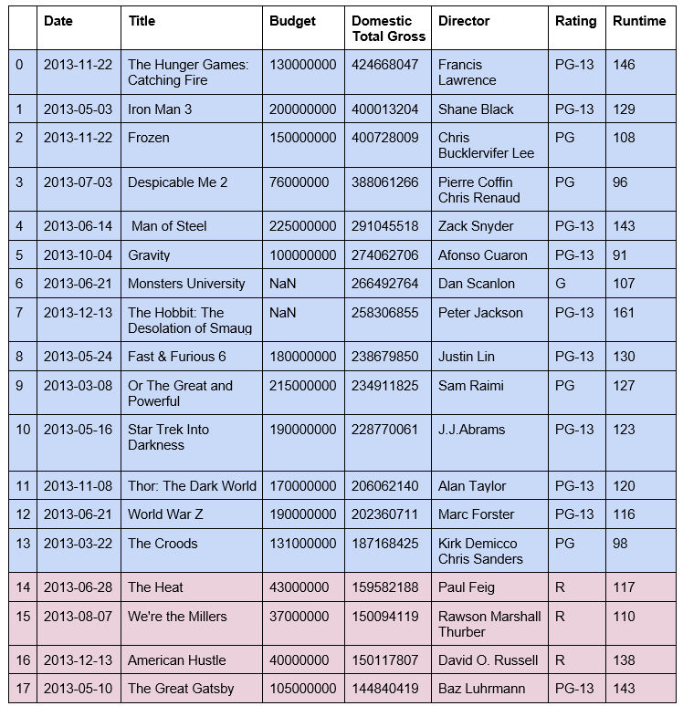
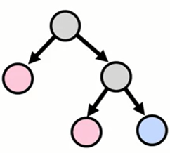
Bagging Error Calculations
Same as decision trees:
- Easy to interpret and implement
- Heterogeneous input data allowed, no preprocessing required

Slide 16

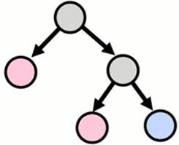
Bagging Error Calculations
Specific to bagging:
- Less variability than decision trees
- Can grow trees in parallel

Slide 17
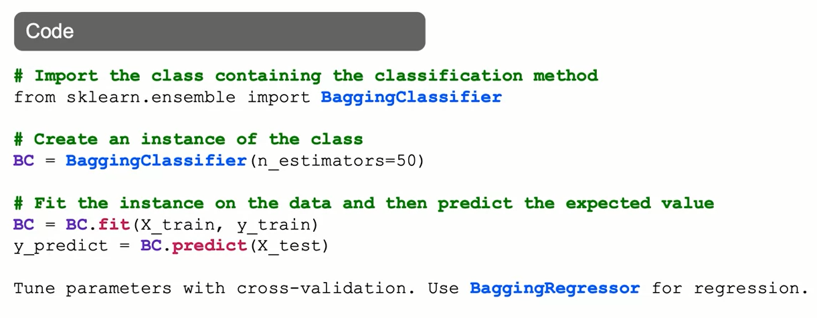
Bagging Classifier: The Syntax

Slide 18
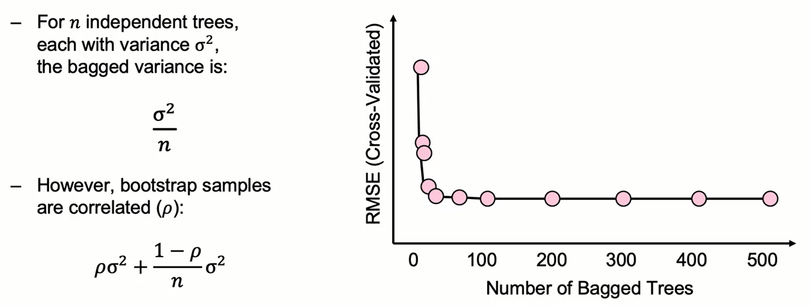
Reduction in Variance Due to Bagging

Slide 19
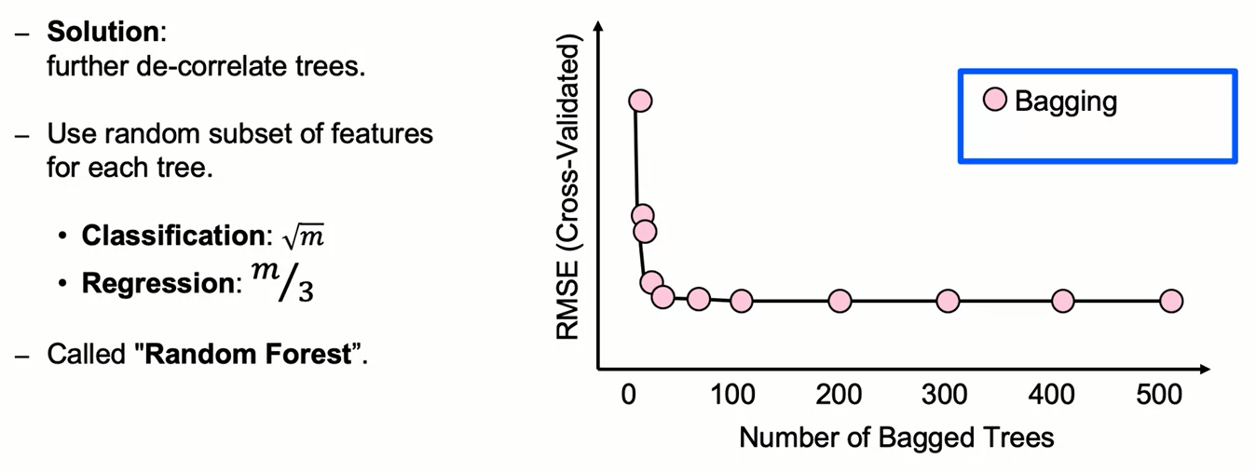
Introducing More Randomness

Slide 20
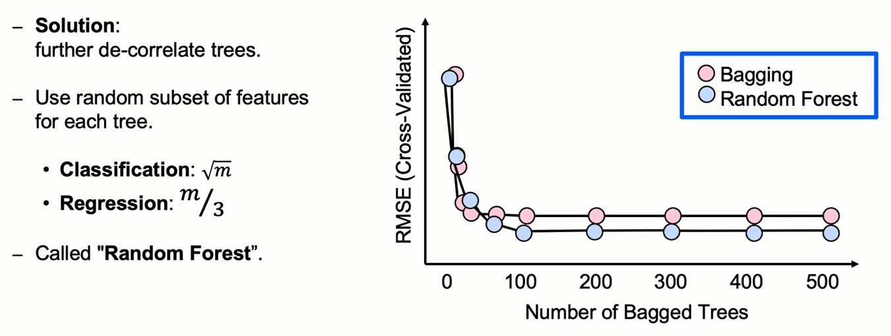
Introducing More Randomness

Slide 21
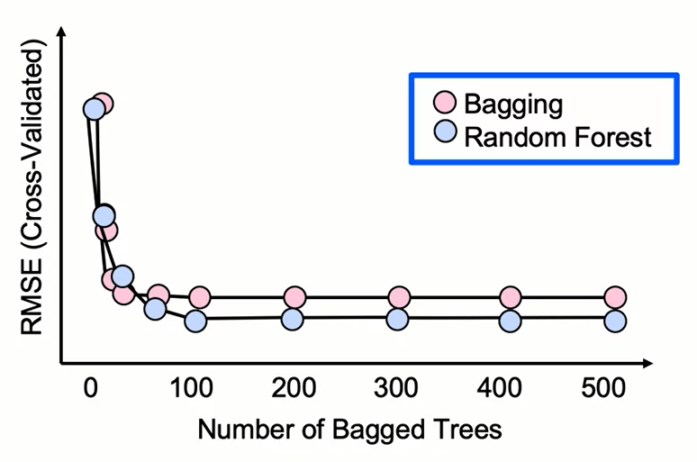
How Many Random Forest Trees?
- Errors are further reduced for Random Forest relative to Bagging.
- Grow enough trees until error settles down.
- Additional trees won't improve results.

Slide 22
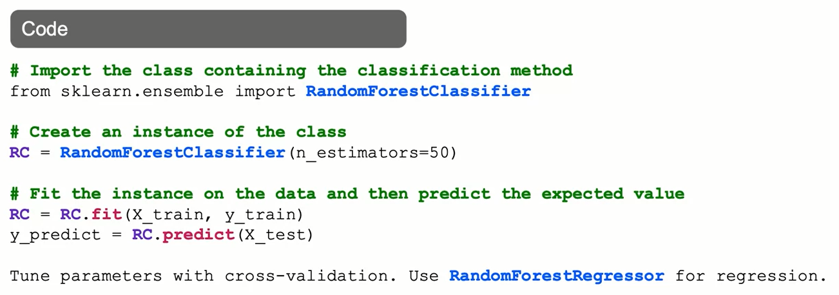
RandomForest: The Syntax

Slide 23
Introducing Even More Randomness
- Sometimes additional randomness is desired beyond Random Forest.
- Solution: select features randomly and create splits randomly — don't choose greedily.
- Called "Extra Random Trees”.

Slide 24
Extra Trees Classifier
Extremely Randomized Trees Classifier(Extra Trees Classifier) is a type of ensemble learning technique which aggregates the results of multiple de-correlated decision trees collected in a “forest” to output it’s classification result. In concept, it is very similar to a Random Forest Classifier and only differs from it in the manner of construction of the decision trees in the forest.
Each Decision Tree in the Extra Trees Forest is constructed from the original training sample. Then, at each test node, Each tree is provided with a random sample of k features from the feature-set from which each decision tree must select the best feature to split the data based on some mathematical criteria (typically the Gini Index). This random sample of features leads to the creation of multiple de-correlated decision trees.

Slide 25
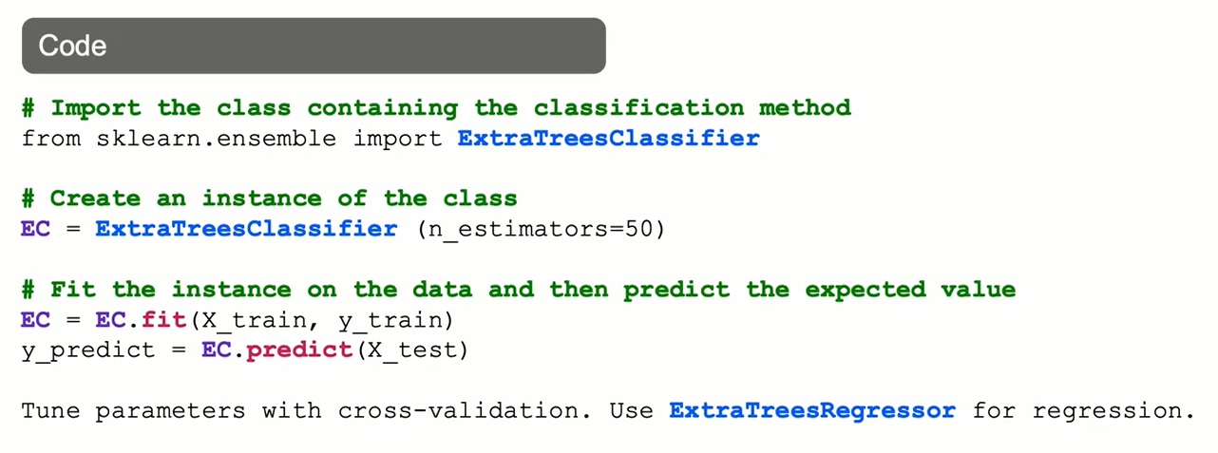
ExtraTreesClassifier: The Syntax

Slide 26
Extra Trees vs Random Forest
The main two differences are the following:
Random forest uses bootstrap replicas, that is to say, it subsamples the input data with replacement, whereas Extra Trees use the whole original sample. In the Extra Trees sklearn implementation there is an optional parameter that allows users to bootstrap replicas, but by default, it uses the entire input sample. This may increase variance because bootstrapping makes it more diversified.
Another difference is the selection of cut points in order to split nodes. Random Forest chooses the optimum split while Extra Trees chooses it randomly. However, once the split points are selected, the two algorithms choose the best one between all the subset of features. Therefore, Extra Trees adds randomization but still has optimization.

Slide 27
Extra Tree vs Random Forest
These differences motivate the reduction of both bias and variance. On one hand, using the whole original sample instead of a bootstrap replica will reduce bias. On the other hand, choosing randomly the split point of each node will reduce variance.
In terms of computational cost, and therefore execution time, the Extra Trees algorithm is faster. This algorithm saves time because the whole procedure is the same, but it randomly chooses the split point and does not calculate the optimal one.

Slide 28
Summary
Ensemble Based Methods and Bagging
Tree ensembles have been found to generalize well when scoring new data. Some useful and popular tree ensembles are bagging, boosting, and random forests. Bagging, which combines decision trees by using bootstrap aggregated samples. An advantage specific to bagging is that this method can be multithreaded or computed in parallel. Most of these ensembles are assessed using out-of-bag error.

Slide 29
Summary
Random Forest
Random forest is a tree ensemble that has a similar approach to bagging. Their main characteristic is that they add randomness by only using a subset of features to train each split of the trees it trains. Extra Random Trees is an implementation that adds randomness by creating splits at random, instead of using a greedy search to find split variables and split points.

Slide 30
Learning Recap
In this section, we discussed:
- Combining models (ensemble-based methods)
- Bootstrap aggregation (Bagging)
- Bagging, Random Forest, and Extra Trees Classifiers

